Slide 1
Salesforce Security Model
Object-Level → Field-Level → Record-Level Security
Prepared from the provided “Salesforce Security Model - II” reference PPT and current Salesforce Help guidance.

Slide 2
Learning Objectives
Understand Salesforce security as three layers: Object, Field, and Record.
Explain Profiles, Permission Sets, Permission Set Groups, Object Permissions, FLS, Page Layouts, Tabs and Record Types.
Explain OWD and the three common sharing models: Private, Public Read Only, Public Read/Write.
Explain how Role Hierarchy extends record access.
Differentiate Owner-Based and Criteria-Based Sharing Rules.
Explain Manual Sharing as a one-off record-level exception.
Explain Restriction Rules as a record filter that narrows visibility.
Build and demonstrate a simple security model in a Developer Org.
Salesforce Security Model • Trainer Edition
2

Slide 3
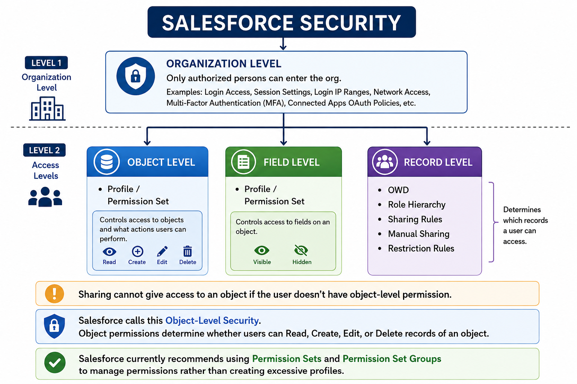

Slide 4
Start With the Big Picture
1. Can I access this object?
2. Can I access this field?
3. Can I access this record?
Object-Level
Field-Level
Record-Level
Profile / Permission Set → Read, Create, Edit, Delete on the object.
FLS → whether a particular field is readable/editable.
OWD + Role Hierarchy + Sharing Rules + Manual Sharing + Restriction Rules.
Salesforce Security Model • Trainer Edition
3

Slide 5
Security Layers: A Real-Life Analogy
Think of an Office Building
Salesforce Translation
• Building entrance → Object permission • Specific cabinet → Field permission • Specific file/folder → Record access • Manager's key → Role hierarchy • Team key → Sharing rule • One-off key → Manual sharing • Security filter → Restriction rule
• Can I enter the Accounts room? • Can I see Salary__c? • Can I see Account A? • Can my manager see my records? • Can Finance automatically see Sales records? • Can I share this one record? • Of the records I could see, which should be filtered?
Salesforce Security Model • Trainer Edition
4

Slide 6
User Access Building Blocks
Profiles and Permission Sets are permission mechanisms; Roles primarily affect record-level access.
User
Profile (base)
Permission Sets / Groups
Object + Field Permissions
Record-Level Access
Key distinction
Profile / Permission Set = what the user is allowed to do. Role = where the user sits in the data-access hierarchy.
Salesforce Security Model • Trainer Edition
5

Slide 7
Profile
Profile = the user's baseline configuration and permissions.
Every Salesforce user has exactly one Profile.
Profiles can define object permissions such as Read, Create, Edit and Delete.
Profiles can define field permissions (FLS), tabs, assigned apps, record types and page layouts.
Profiles can also contain many user/system permissions and login-related settings.
Think of a Profile as the user's base permission package—not the record-sharing model.
Easy example
Sales Rep Profile: Account → Read/Create/Edit, Delete = No Opportunity → Read/Create/Edit, Delete = No
Salesforce Security Model • Trainer Edition
6

Slide 8
Permission Sets
Permission Sets add permissions without changing the user's Profile.
A user can have multiple Permission Sets.
Use them when only some users need additional access.
They can grant object, field and user/system permissions.
They are ideal for modular, reusable access instead of creating many specialized Profiles.
A Permission Set does not normally take away a permission already granted by the user's Profile.
Example
50 Sales Reps share one Profile. 5 reps need Account Delete. Create one Permission Set: “Account Delete Access” and assign it only to those 5 users.
Memory line
Profile = base Permission Set = extra
Salesforce Security Model • Trainer Edition
7

Slide 9
Permission Set Groups
Bundle multiple Permission Sets and assign them as one unit.
Finance User
Finance Access Permission Set Group
Account Read Opportunity Read Report Access Export Access
Permission Set = one reusable permission bundle.
Permission Set Group = a collection of Permission Sets.
Useful when a job function consistently needs several permission sets.
You can assign multiple Permission Set Groups to the same user.
Salesforce Security Model • Trainer Edition
8

Slide 10
Object-Level Security
Object permissions answer: “Can this user access this object at all?”
Permission | Meaning
Read | View records of the object, subject to record access.
Create | Create records of the object, subject to required fields and rules.
Edit | Update records the user is allowed to edit.
Delete | Delete records the user is allowed to delete.
View All / Modify All | Powerful object-level access that can override normal sharing behavior.
Critical rule
Sharing cannot make a user read an object they do not have object-level Read permission for.
Example
Profile: Opportunity Read = Yes OWD: Opportunity = Private Result: user can use the Opportunity object, but cannot automatically see every Opportunity record.
Salesforce Security Model • Trainer Edition
9

Slide 11
Other Object-Level / UI Settings
These settings affect what users can access or how the object is presented.
Setting | Simple purpose
Tab Visibility | Whether the object tab is shown/available in the UI.
App Access | Which Salesforce apps the user can access.
Record Types | Which business processes / picklist values / page layouts are available.
Page Layouts | Which fields, sections, buttons and related lists appear on the page.
Object Permissions | Whether the user can Read/Create/Edit/Delete the object records.
Security reminder
Hiding a tab or removing a field from a page is not a substitute for object permissions or FLS.
Salesforce Security Model • Trainer Edition
10

Slide 12
Field-Level Security (FLS)
FLS answers: “Can this user see or edit this particular field?”
FLS controls field visibility and editability for a user.
It applies across the Salesforce UI and is an important security layer for API/report/search access as well.
FLS can be configured in Profiles and Permission Sets; Salesforce recommends Permission Sets / Permission Set Groups for scalable permission management.
If FLS says a field is hidden, putting the field on a page layout does not expose it.
FLS is different from record access: a user can have access to a record but still be unable to see a sensitive field.
Example
Opportunity fields: Amount → Visible/Edit Stage → Visible/Edit Commission__c → Hidden
Salesforce Security Model • Trainer Edition
11

Slide 13
FLS vs Page Layout
Use FLS for security; use Page Layouts primarily for page organization.
Scenario | Result
Page Layout = Visible; FLS = Visible | Field is visible.
Page Layout = Hidden; FLS = Visible | Field is not shown on that layout.
Page Layout = Visible; FLS = Hidden | Field remains hidden.
Page Layout = Required; FLS = Read Only | FLS wins; field remains read-only.
Rule to remember
The more restrictive field access wins between FLS and Page Layout.
Salesforce Security Model • Trainer Edition
12

Slide 14
Object + Field + Record Access Together
A user needs the right permission at each relevant layer.
Object Permission
Field Permission
Record Access
Effective Access
Example
Second example
John has Opportunity Read = Yes. OWD = Private. John does not own Sarah's Opportunity. → John can access the object, but not Sarah's record unless another sharing mechanism grants access.
John has record access to the Opportunity, but Commission__c is hidden by FLS. → John sees the record but not that field.
Salesforce Security Model • Trainer Edition
13

Slide 15
Record-Level Security
Now we move from “what can the user do?” to “which records can the user access?”

Slide 16
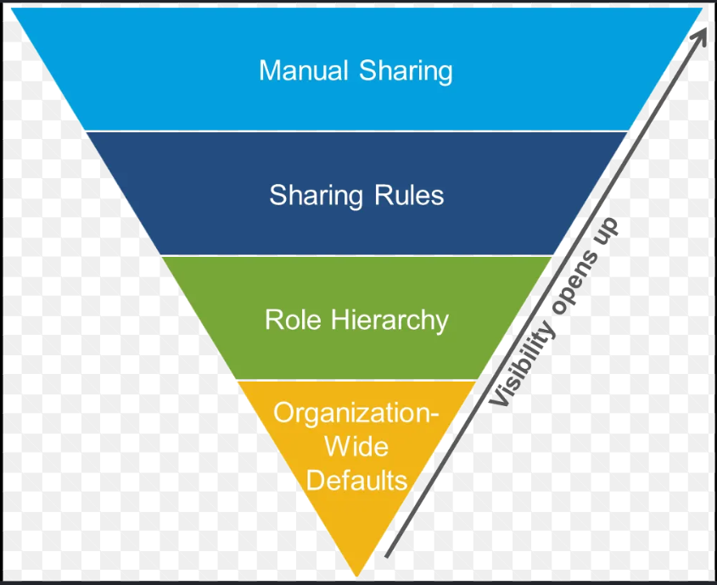
Organization Wide Default-
OWD establishes the baseline.
Role Hierarchy
Usually opens up access to people higher in the hierarchy.
Sharing Rule
Opens up access to additional users/groups.
Manual Sharing
Opens up access to a particular user/group for a particular record.
Restriction Rule
Filters/restricts records that a user would otherwise have access to.
So remember:
OWD = Start here
Role Hierarchy = Open upward
Sharing Rule = Open automatically
Manual Sharing = Open one specific record
Restriction Rule = Filter back down

Slide 17
Organization-Wide Defaults (OWD)
OWD sets the baseline/default record access for users who do not own the record.
OWD is a record-level security setting configured per object.
It answers: “By default, what can users do with records they do not own?”
A common best practice is to start with the most restrictive baseline needed, then open access with other sharing mechanisms.
OWD is not the final answer: Role Hierarchy, Sharing Rules, Manual Sharing and other mechanisms can extend access.
OWD settings can differ by object; internal and external access can also have separate settings where supported.
Think of OWD as
The starting line. Not a permanent wall.
Common design pattern
Private baseline → selectively open access.
Salesforce Security Model • Trainer Edition
15

Slide 18
OWD: Common Sharing Models
OWD | Default visibility | Default editability
Private | Users see records they own / otherwise receive access to. | Only owners / users granted edit access can edit.
Public Read Only | All users with object access can read records. | Editing still depends on ownership or additional access.
Public Read/Write | All users with object access can read records. | All users with object access can generally edit records.
question
If OWD is Private, can another user ever see the record? YES—through other sharing/access mechanisms.
Salesforce Security Model • Trainer Edition
16

Slide 19
OWD Example
objective: prove that Private means “not shared by default,” not “never shareable.”
John owns Client A
OWD = Private
Sarah logs in
Sarah cannot see Client A
Then change the story
Create a sharing mechanism later and show Sarah gaining access. This makes the difference between baseline access and extended access obvious.
Trainer cue: Ask trainees to predict the result before logging in as Sarah.
Salesforce Security Model • Trainer Edition
17

Slide 20
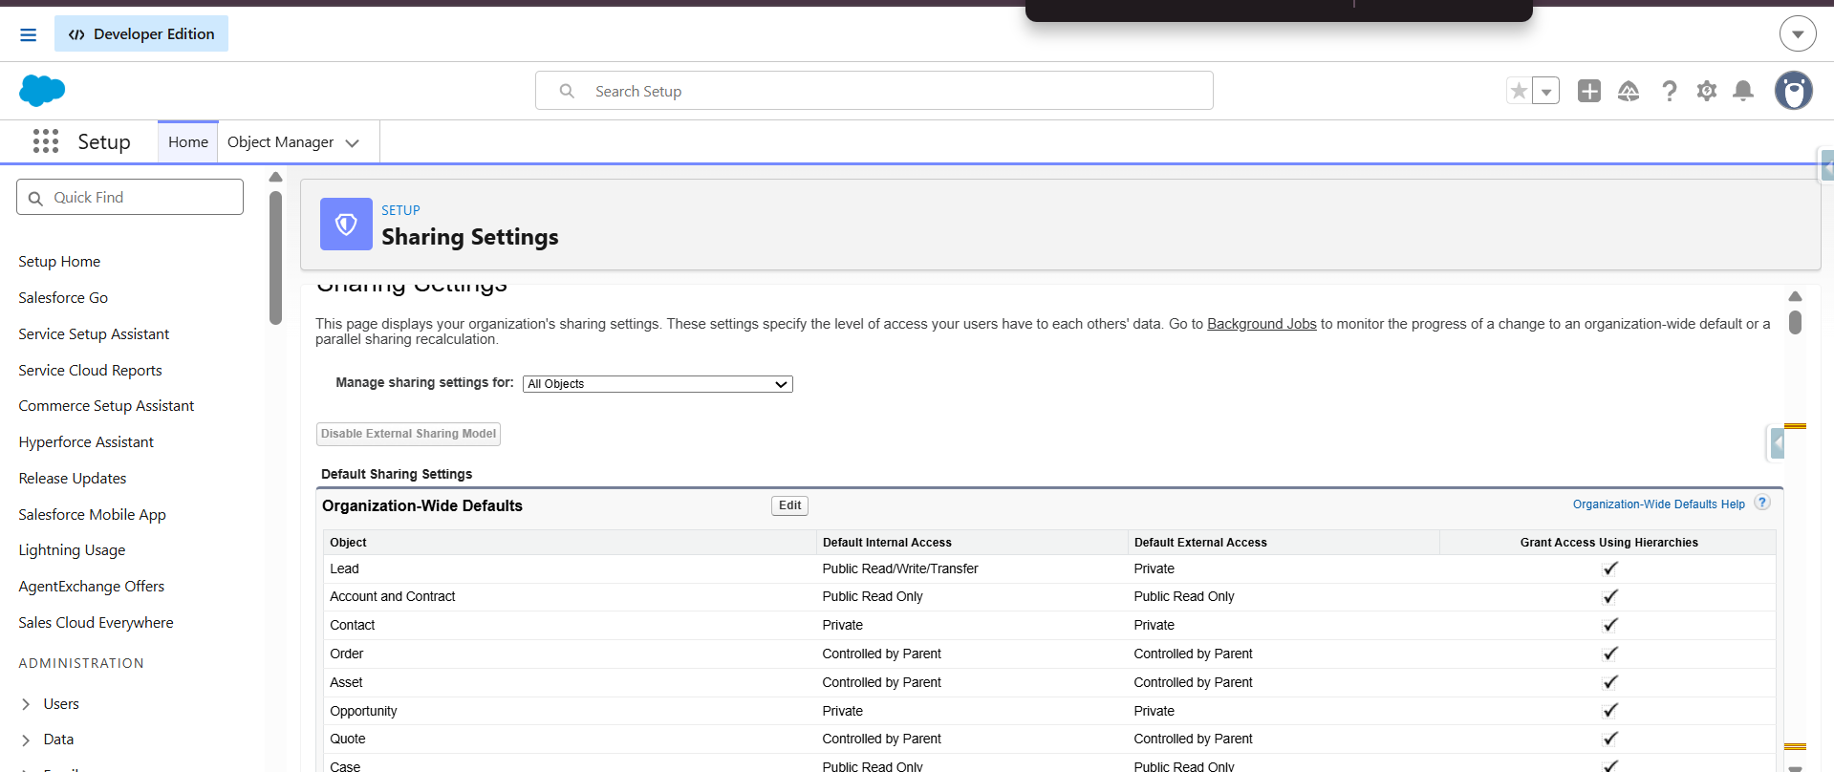

Slide 21
In Salesforce, Default Internal Access and Default External Access are the baseline Organization-Wide Defaults (OWD) that set initial record visibility for an object. Internal access controls what regular employee users see, while external access controls what community or partner users see in Experience Cloud.
Default Internal Access
Applies to regular employees and users with standard Salesforce licenses.
Sets the base level view and edit permissions for staff inside your company.
Example: If set to Private, employees only see records they own unless a role hierarchy or sharing rule opens access.
Default External Access
Applies to outside partners, customers, or users with Experience Cloud licenses.
Controls baseline data visibility for external portal or community users.
Must always be equal to or more restrictive than the internal access level (you cannot give outsiders more open default access than your own internal team).

Slide 22
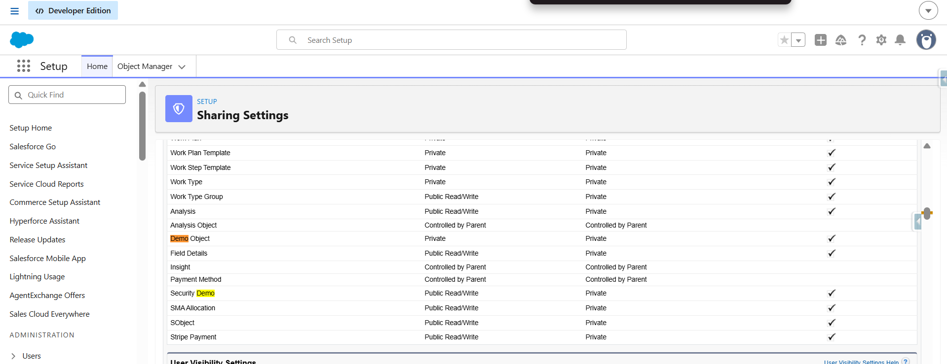

Slide 23
Role Hierarchy
Role Hierarchy extends record access vertically in the hierarchy.
CEO
Sales Manager
Sales Rep
Users higher in the hierarchy can generally access records owned by users below them, subject to object and sharing configuration.
The hierarchy is about data access, not necessarily the company's exact HR reporting structure.
Roles do not replace Profiles or Permission Sets.
For custom objects, “Grant Access Using Hierarchies” can be disabled; standard objects have their own supported behavior.
Salesforce Security Model • Trainer Edition
18

Slide 24
Profile vs Role: Common Confusion
Profile / Permission Set | Role / Role Hierarchy
Controls object and field permissions. | Primarily affects record-level access.
Answers “What can you do?” | Answers “Which records can you access because of your position?”
One Profile per user; multiple Permission Sets possible. | A user can be assigned a role; roles form a hierarchy.
Example: Opportunity Edit = Yes. | Example: Sales Manager can access Sales Rep records.
Memory trick
Profile = permissions Role = record access position
Salesforce Security Model • Trainer Edition
19

Slide 25
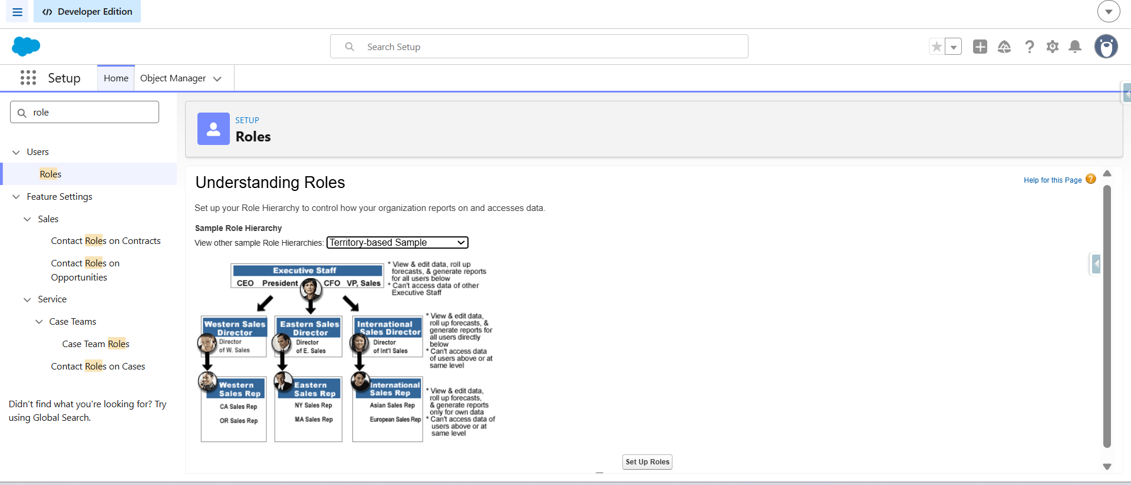

Slide 26
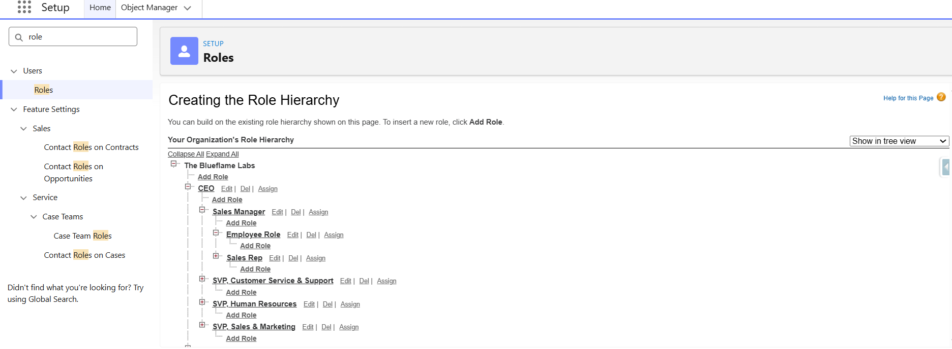

Slide 27
Sharing Rules
Sharing Rules automatically extend record access to groups of users.
Sharing Rules are exceptions to the OWD baseline.
They can extend access to users, roles, territories or public groups depending on the supported sharing target.
Owner-based sharing rules share records based on who owns them.
Criteria-based sharing rules share records based on field values on the record.
Sharing Rules are designed to open access—not to make access more restrictive than OWD.
Business requirement
“All Sales Opportunities should be readable by Finance.” → A Sharing Rule is a strong candidate.
Not a Sharing Rule
“Only show Finance users West records.” → That is a filtering/restriction requirement.
Salesforce Security Model • Trainer Edition
20

Slide 28
Sharing Rules: Owner-Based vs Criteria-Based
Type | Question it answers | Example
Owner-Based | Who owns the records that should be shared? | Share records owned by Sales roles with Finance Group.
Criteria-Based | What field values identify the records? | Share records where Region = West with West Finance Group.
Salesforce Security Model • Trainer Edition
21

Slide 29
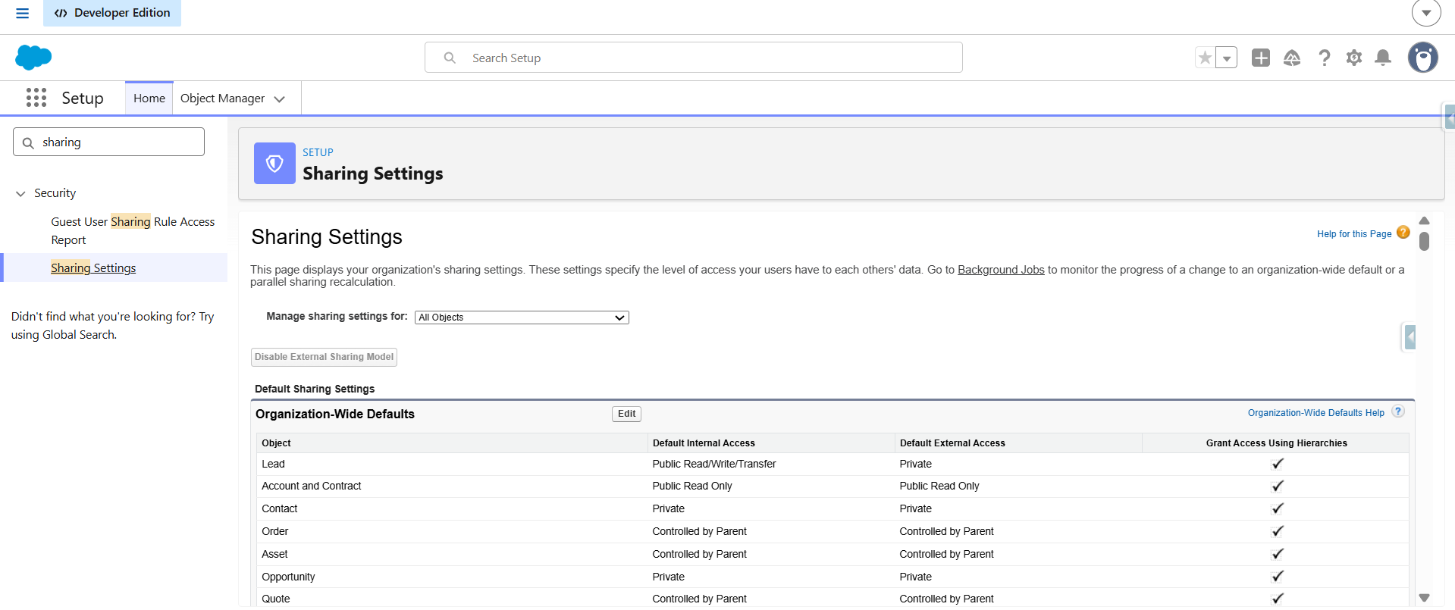

Slide 30
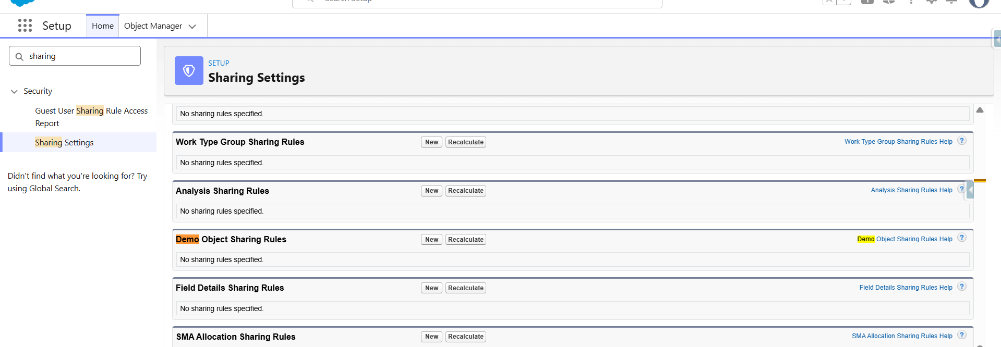
At bottom:

Slide 31
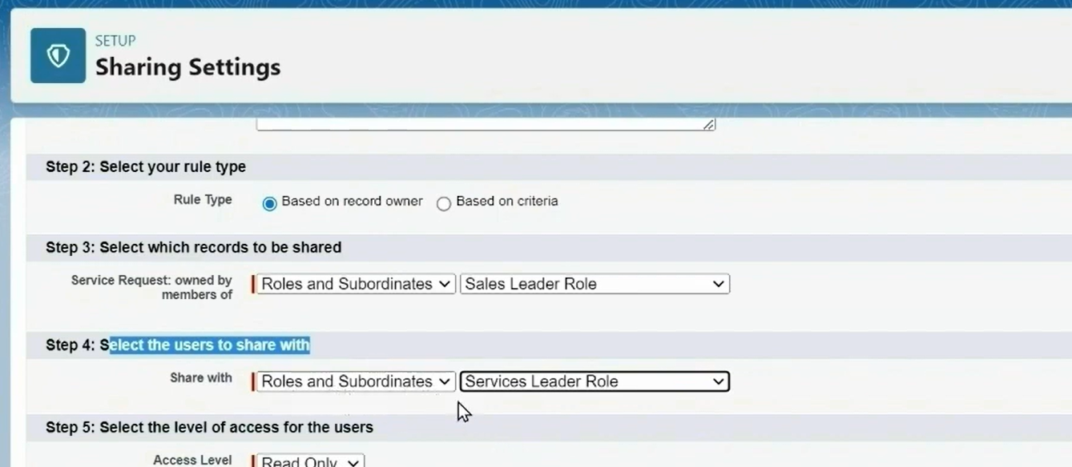

Slide 32
Public Groups
A Public Group is a reusable collection of users/roles/groups used by sharing and other Salesforce features.
John Sarah Finance User
Finance Team Public Group
Sharing Rule
Sales Records
A group can contain individual users and, depending on configuration, roles or other groups.
Public Groups make sharing rules easier to manage because you share to the group instead of maintaining many individual users.
Salesforce Security Model • Trainer Edition
22

Slide 33
Manual Sharing
Manual Sharing is a one-off record-level sharing exception.
John owns Client A
Click Share
Select Finance User
Read/Write
Finance User can access
Useful when a specific record needs to be shared but there is no consistent rule for a whole group of records.
It is not the right tool for sharing thousands of records one-by-one.
Record owners can manually share records where supported.
Manual sharing does not replace object permissions; the recipient still needs the necessary object-level access.
Salesforce Security Model • Trainer Edition
23

Slide 34
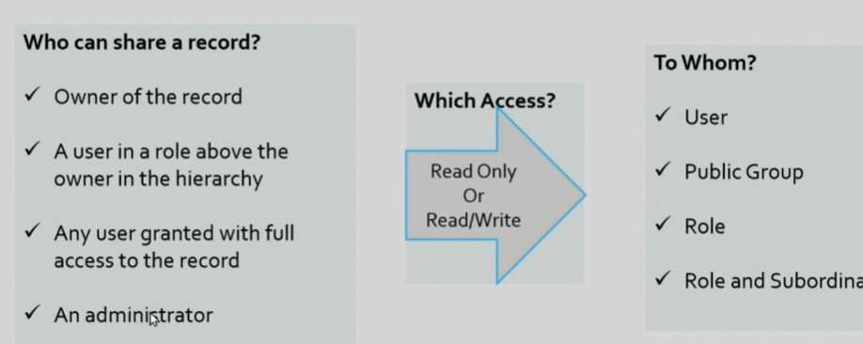
Note : In order to Perform the Manual sharing the records object ‘OWD’ needs to be ‘Private or Read only’. If the OWD is Public Read/Write then there will not be any Sharing option available on that record because all the ‘public’ already have read write access.

Slide 35
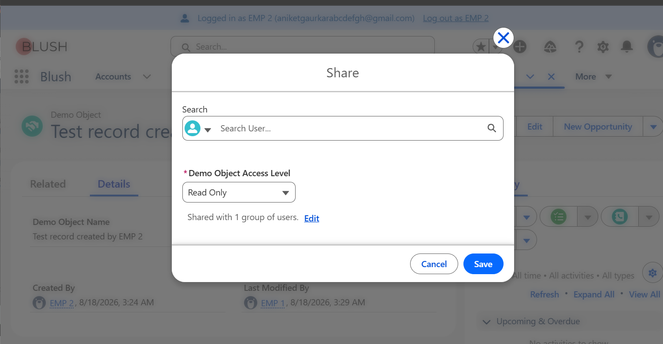

Slide 36
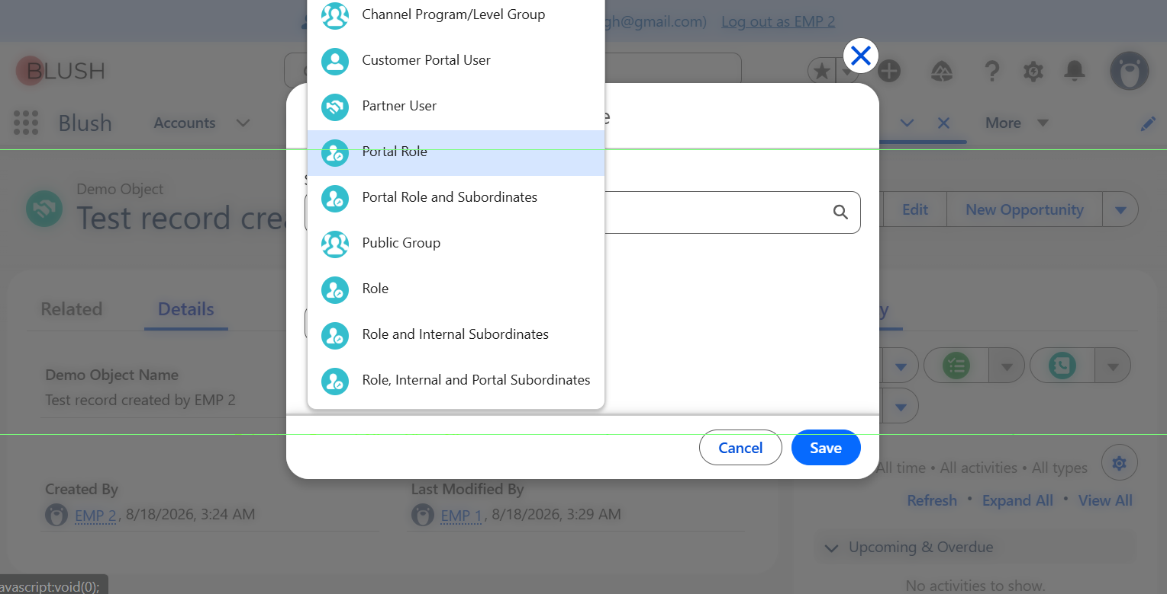

Slide 37
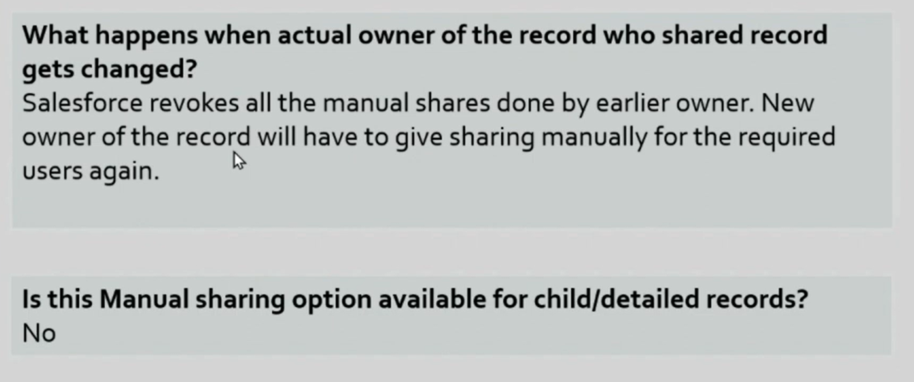

Slide 38
Sharing Rule vs Manual Sharing
Question | Sharing Rule | Manual Sharing
Automatic? | Yes | No
Typical scope | Many records / recurring requirement | One or a few specific records
Based on criteria? | Yes, for criteria-based rules | No
Best use | Consistent business requirement | One-off collaboration
Example | All Sales records → Finance | ABC Client → Sarah
Recurring requirement → Sharing Rule. One-off exception → Manual Sharing.
Decision rule
Salesforce Security Model • Trainer Edition
24

Slide 39
Restriction Rules
Restriction Rules narrow the records a user can access by filtering their available record set.
A Restriction Rule applies a record filter to a targeted user group.
The user may already have access through OWD, sharing rules or other sharing mechanisms.
The restriction rule filters that access so the user can see only records matching the specified criteria.
It does not remove the user's object-level Read/Edit permission.
Available in Lightning Experience for supported objects and editions.
Easy definition
Sharing Rule: “Give this group more records.” Restriction Rule: “Of the records available to this group, show only these.”
Salesforce Security Model • Trainer Edition
25

Slide 40
Imagine:
OWD = Public Read Only
Therefore:
John
Therefore,
can see 100 records
But business says:
"John should only see records where Region = West."
We don't want to change OWD.
Create:
Restriction Rule
User:
John
Record:
Region = West
Now:
100 records available normally ----> After Restriction Rule Restriction Rule
30 West records visible
The other 70 are filtered out.

Slide 41
Restriction Rule Example
Business requirement: Finance can access Sales records, but only West records.
100 Sales records
Sharing Rule → Finance
Finance has 100 records
Restriction Rule Region = West
Finance sees 30 records
Before restriction
After restriction
Client A – West ✅ Client B – East ✅ Client C – West ✅ Client D – East ✅
Client A – West ✅ Client B – East ❌ Client C – West ✅ Client D – East ❌
Salesforce Security Model • Trainer Edition
26

Slide 42
WD = Private
Sharing Rule → gives John access to 100 records
Then:
Restriction Rule
Region = West
John may only see:
30 West records
So Restriction Rule can reduce the effective record visibility after other sharing mechanisms have granted access.
This is why Salesforce describes restriction rules as further scoping data that users already have access to.

Slide 43
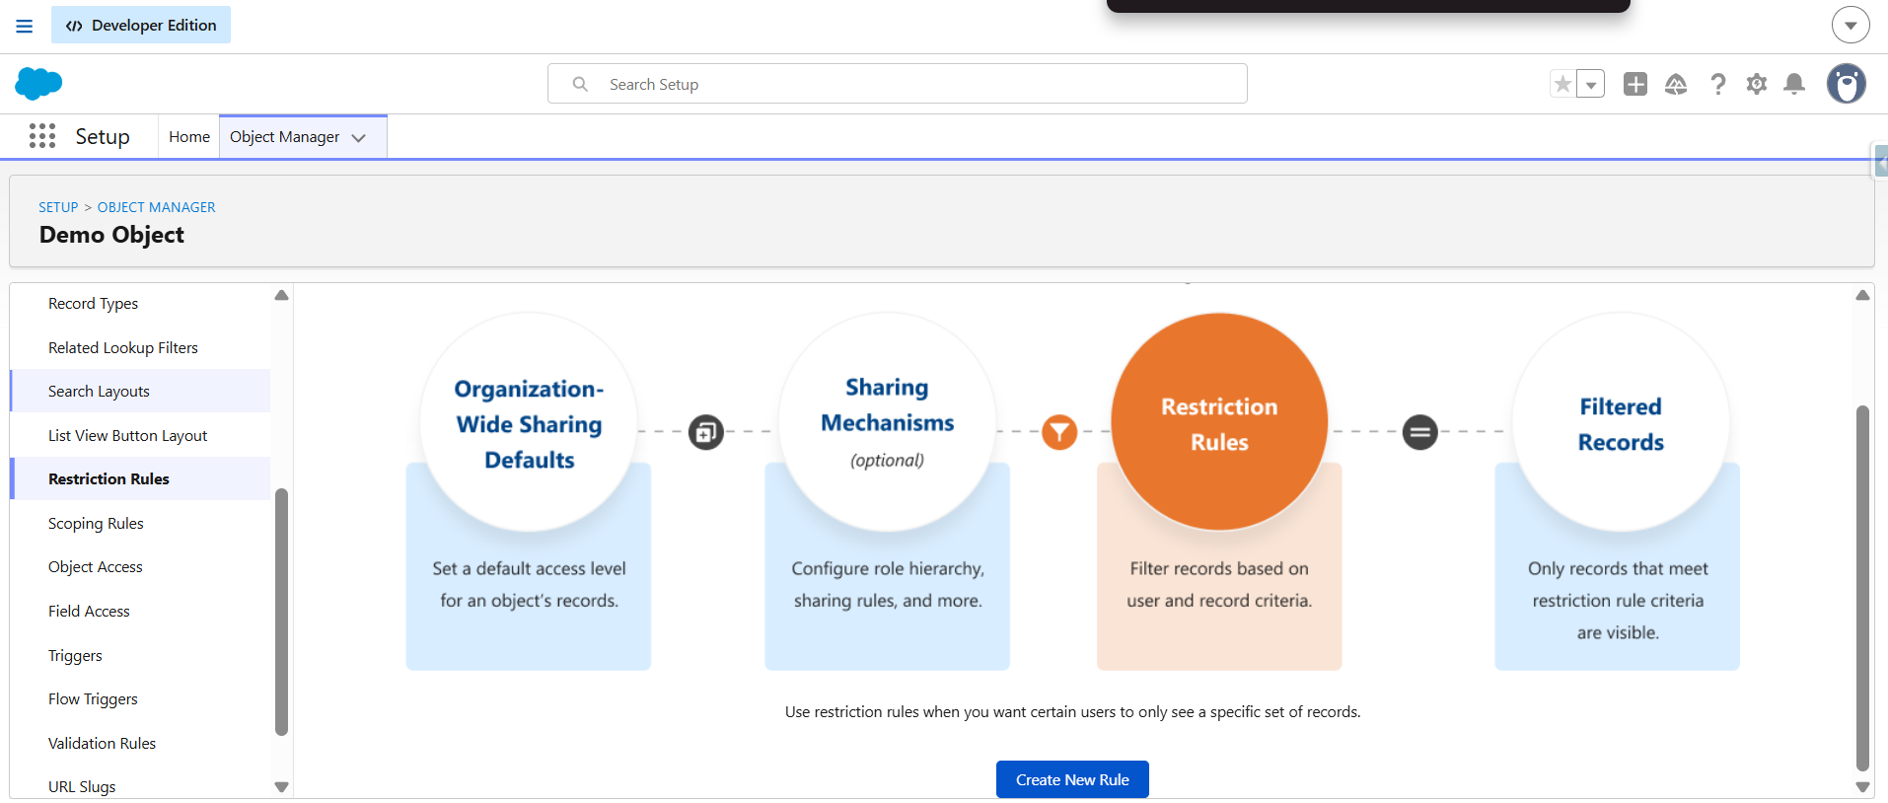

Slide 44
Sharing Rule vs Restriction Rule
Sharing Rule | Restriction Rule
Expands record access. | Filters / narrows record visibility.
“Share these records with Finance.” | “Finance can only see West records.”
Designed to make more records available. | Designed to refine which records are visible.
Works as an additional access grant. | Filters records the user otherwise has access to.
Memory line
SHARING = ADD RESTRICTION = FILTER
Salesforce Security Model • Trainer Edition
27

Slide 45
The End-to-End Security Model
A single user can be affected by several layers at the same time.
Profile / Permission Set
Object Permission
FLS
OWD
Role / Sharing
Restriction Filter
Example outcome
John has Opportunity Read permission → can use the object. OWD = Private → he does not see every record. Role Hierarchy / Sharing Rule → additional records become available. FLS hides Commission__c → field remains invisible. Restriction Rule → some otherwise-available records may be filtered.
Salesforce Security Model • Trainer Edition
28

Slide 46
In Salesforce, View All Records, Modify All Records, and View All Fields are powerful object-level permissions.
They let users bypass normal sharing rules, role hierarchies, and field security settings for a specific object.
View All Records (View All)-
What it does: Lets a user view every record for a specific object, even if sharing settings are private.
Key detail: It ignores sharing rules and role hierarchies, but it does not let the user edit or delete records.
Use case: Managers or auditors who need to read all data across a department without owning the records.
Modify All Records (Modify All)-
-What it does: Lets a user view, edit, create, and delete all records for a specific object.
Key detail: It overrides sharing rules, meaning users can edit or delete records they do not own.
Use case: Data cleanup teams or system administrators who need full control over a specific object's data.
View All Fields-
What it does: Lets a user view every single field on a specific object's records.
Key detail: It overrides Field-Level Security (FLS). If a regular profile hides a sensitive field (like a salary or ID number), this permission unhides and shows it.
Use case: Special integration users, reporting tools, or compliance officers who require total data transparency for that object.

Slide 47
Common Questions
If OWD is Private, can a manager still see a rep's records?
Can a Sharing Rule make access more restrictive than OWD?
Can a Permission Set give someone access to a record they cannot otherwise access?
If FLS hides a field but Page Layout shows it, what happens?
Is Role the same as Profile?
Is Manual Sharing suitable for 10,000 recurring records?
Can a Restriction Rule filter records a user otherwise has access to?
Does a Restriction Rule remove object Read permission?
Salesforce Security Model • Trainer Edition
29

Slide 48
Demo
Use the same sequence every time you teach this topic.
1
Set OWD = Private
Login as John/Sarah and prove users see their own records.
2
Show Role Hierarchy
Login as Sales Manager and show access to rep records.
3
Create Public Group
Finance Team contains Finance User.
4
Create Sharing Rule
Department = Sales → Finance Team → Read Only.
5
Manual Share
John shares Client A with Finance User → Read/Write.
6
Restriction Rule
Finance sees only Region = West records.
Salesforce Security Model • Trainer Edition
32

Slide 49
Troubleshooting: “Why Can’t This User See the Record?”
1. Does the user have object-level Read permission?
2. Is the field hidden by FLS?
3. Who owns the record?
4. What is the OWD for the object?
5. Is the user above the owner in the role hierarchy?
6. Is there a Sharing Rule, Public Group, Queue or other sharing mechanism?
7. Was the record manually shared?
8. Is a Restriction Rule filtering the record?
9. Does the user have powerful permissions such as View All / Modify All that change the expected result?
Salesforce Security Model • Trainer Edition
33

Slide 50
Mini Quiz: Test Their Understanding
Q1
OWD = Private. John owns Opportunity A. Sarah has Opportunity Read permission. Can Sarah automatically see A?
Q2
Sarah is above John in the role hierarchy. Can she generally access John's records?
Q3
Finance needs access to all Sales records. Sharing Rule or Manual Sharing?
Q4
John wants to share only one Opportunity with Sarah.
Q5
Finance can access Sales records but only West records should be visible.
Q6
Page Layout shows Salary__c but FLS hides it.
Salesforce Security Model • Trainer Edition
34

Slide 51
Final Cheat Sheet
If trainees remember only one slide, make it this one.
Feature | Question it answers | Memory line
Profile | What is the user's base permission? | Base access
Permission Set | What extra permission does this user need? | Add access
Object Permission | Can the user access the object? | Object gate
FLS | Can the user see/edit this field? | Field gate
Page Layout | What does the page look like? | Page design
OWD | What is the default record access? | Baseline
Role Hierarchy | Who gets access higher in the hierarchy? | Open upward
Sharing Rule | Who should automatically get more records? | Open automatically
Manual Sharing | Who should get this one record? | One-off share
Restriction Rule | Which records should be filtered? | Filter visibility
Salesforce Security Model • Trainer Edition
35

